Slide 1
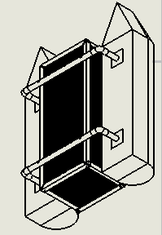
THE DESIGN OF A DEBRIS CLEARING VESSEL
Presented By:
Mohsin Mehmood
& Hafeez Shittu

Slide 2
Outline
Back ground
Project Objective
Design Requirements
Design Constraints
Design Approach
Tasks
Implementation
Conclusion

Slide 3
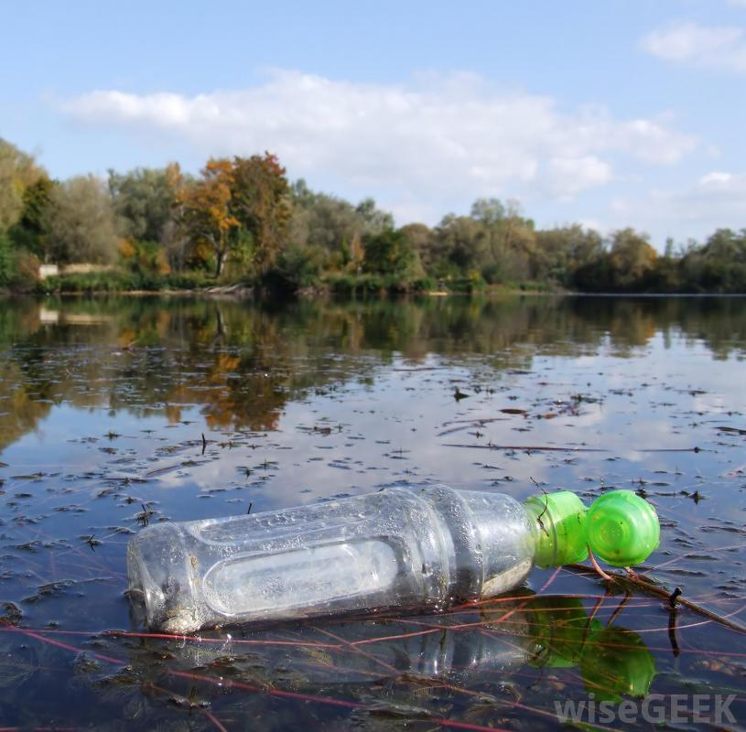
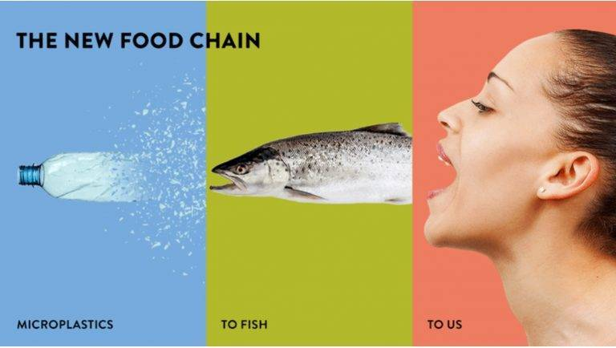
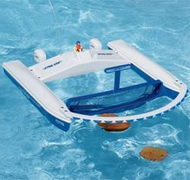
Background
Motivation
Plastics and its harmful effects.
Innovating Existing products.

Slide 4
Project Objective
The objective of this project is to design a Catamaran (dual hull) marine vessel, capable of detecting plastic bottles using machine learning and navigate toward them.

Slide 5
Design Requirements
The main frame of the vehicle should be able to support up to 60 lbs. of total load, including the Payload up to 20 lbs. and 25 lbs. of vehicle itself.
The motors should drive the vehicle with the velocity of 5 miles per hour.
Recognize floating plastic bottles using machine learning.
Should recognize the target (Volume 500 ml, height 23.50 cm, diameter 6.58 cm, max weight .54 kg and function intelligently.

Slide 6
Design Constraints
Budget
Weather conditions.
Limited Resources.

Slide 7
Design Approach
Research Various Boat designs
Preliminary Boat designs
Weight Calculations
Hydrostatic study
Fluid dynamics calculations
CAD Simulation
Flow analysis
FEM analysis
Building a Prototype

Slide 8
Design Approach (Continued)
Electrical components/ Power Analysis
Image Recognition
Navigation System

Slide 9
Tasks
Task 1: Research Various Boat designs
Task 2: Preliminary boat design
Task 3: Weight Calculations
Task 4: Hydrostatic evaluation
Task 5: Fluid dynamics evaluation
Task 6: CAD simulations
Task 7: Building the prototype
Task 1. Research various design
approach
Task 2. Power Analysis/Component
Task 3. Image Recognition System
Task 4. Navigation System
Task 5. Assemble the component

Slide 10
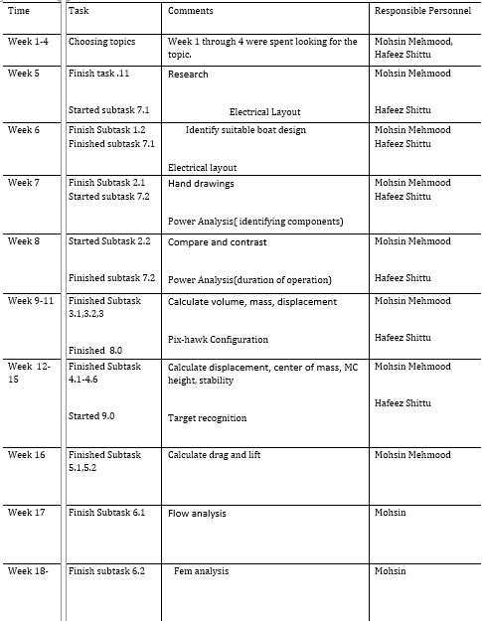
Project Timeline

Slide 11
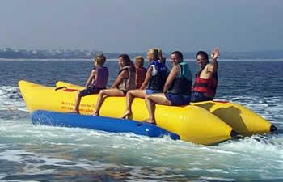
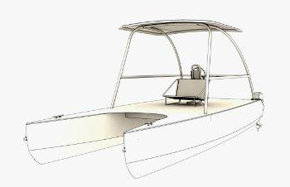
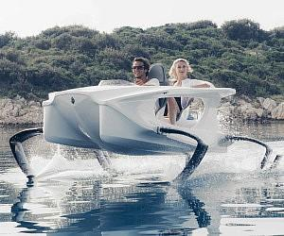
Implementation: (Task 1)
Research
Banana Boats
Hydrofoil boats
Catamaran Boats
Pontoons and its advantages:
Ease of Use/Maintenance
Building Cost and Storage
Longevity

Slide 12
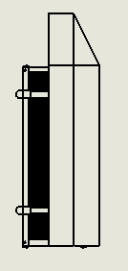
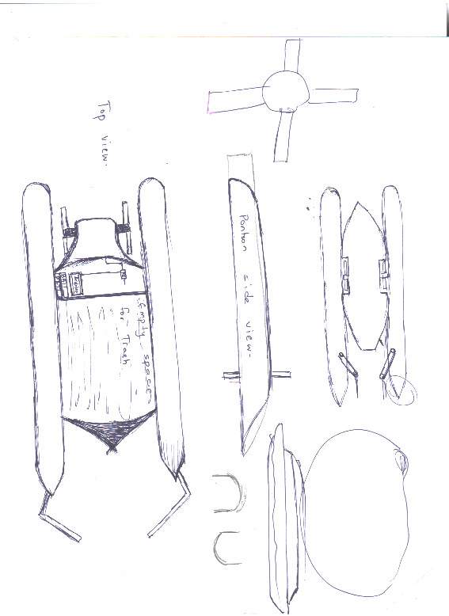
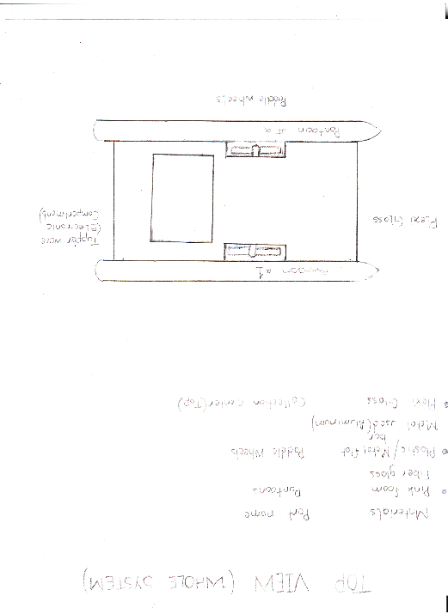
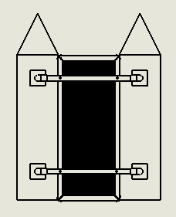
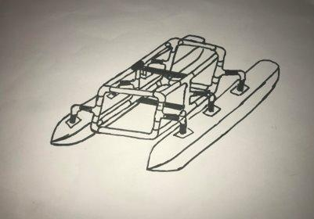
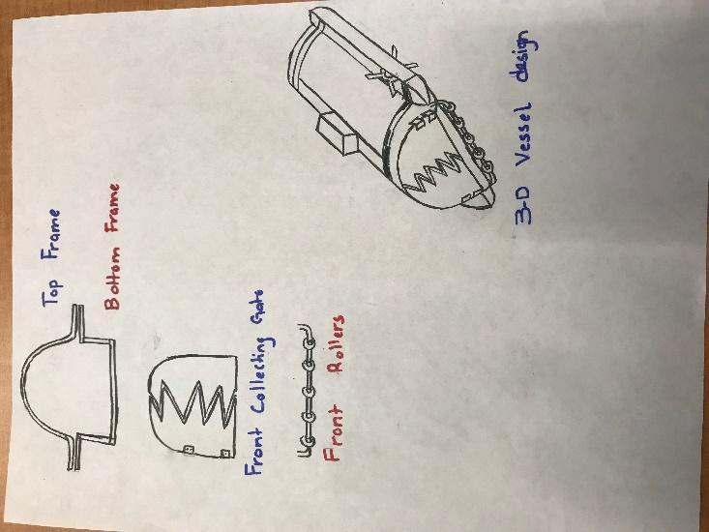
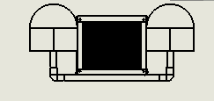
Implementation of Task 2.
Earlier designs:
Final Design:

Slide 13
Implementation of Task 3
Total Volume Total Mass
Parts | Volume
Half Cylinder
Front Cone
Wooden Cubes
Rectangular blocks
PVC 18.5 inch
PVC 4 inch
PVC Elbow
Aluminum Angle Bar 28 inch
Aluminum Angle Bar 12 inch
Aluminum Box Bar 12 inch
Aluminum Mesh
Total Volume
Parts | Mass
Half Cylinder | 0.48426 kg
Front Cone | 0.13272 kg
Wooden Cubes | 0.92208 kg
Rectangular blocks | 0.5712 kg
PVC 18.5 inch | 0.1352 kg
PVC 4 inch | 0.058 kg
PVC Elbow | 0.08008 kg
Aluminum Angle Bar 28 inch | 0.120204 kg
Aluminum Angle Bar 12 inch | 0.538 kg
Aluminum Box Bar 12 inch | 0.752 kg
Aluminum Mesh | 2.85 kg
Screws | 0.117 kg
Total Mass | 6.760744 kg

Slide 14
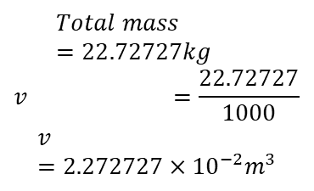
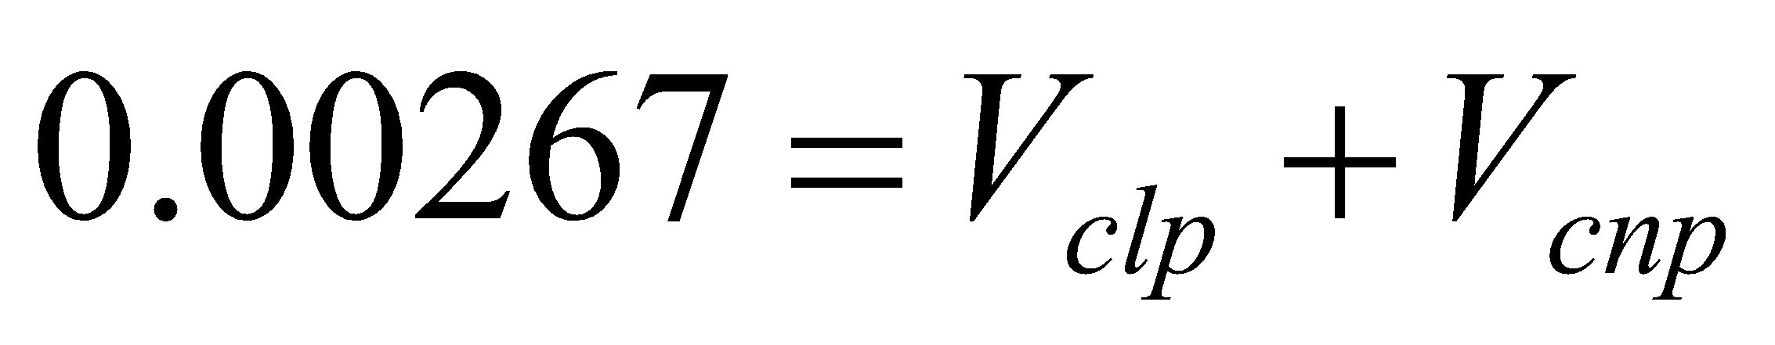
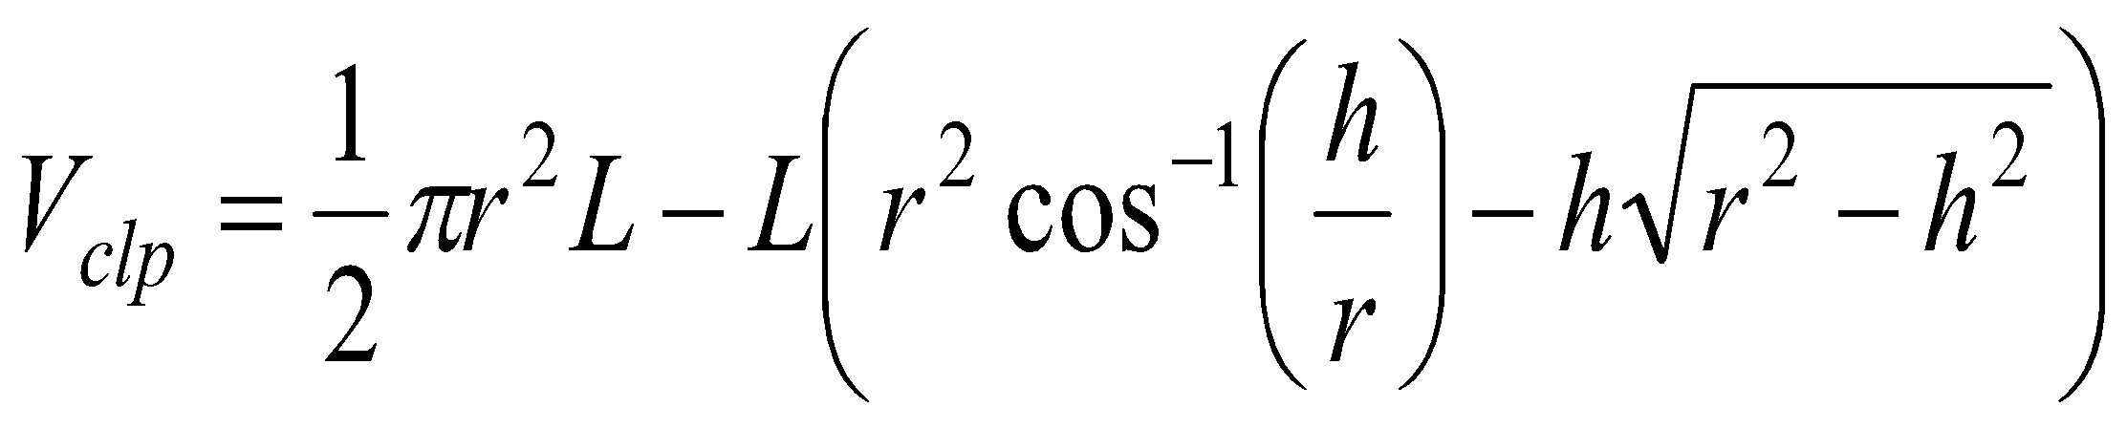
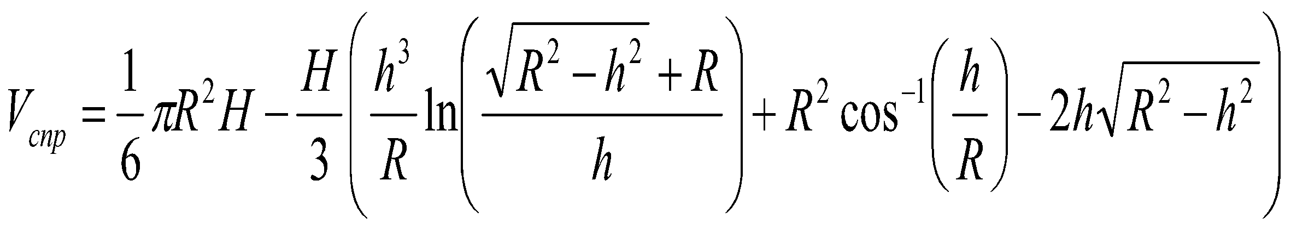
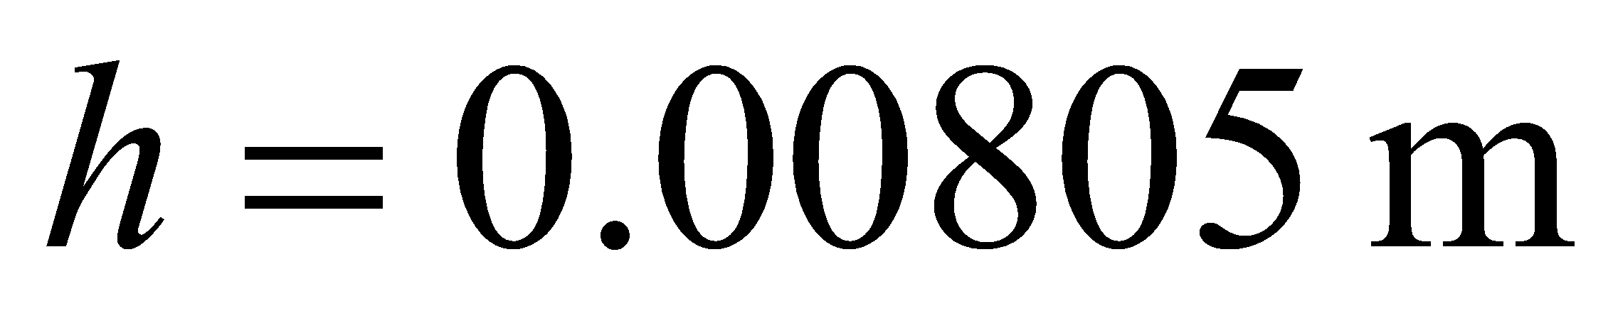
Implementation of task 4
Total Mass breakdown:
Total Water Displacement:
Height of Submerged Ship:
Total weight of the building materials = 6.760744 kg =>14.8736368 pounds
The mass of electronics = 10.17 pounds
Maximum Mass of the payload = 25 pounds
Total weight =22.72727 kg

Slide 15
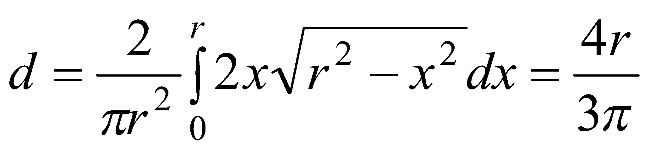
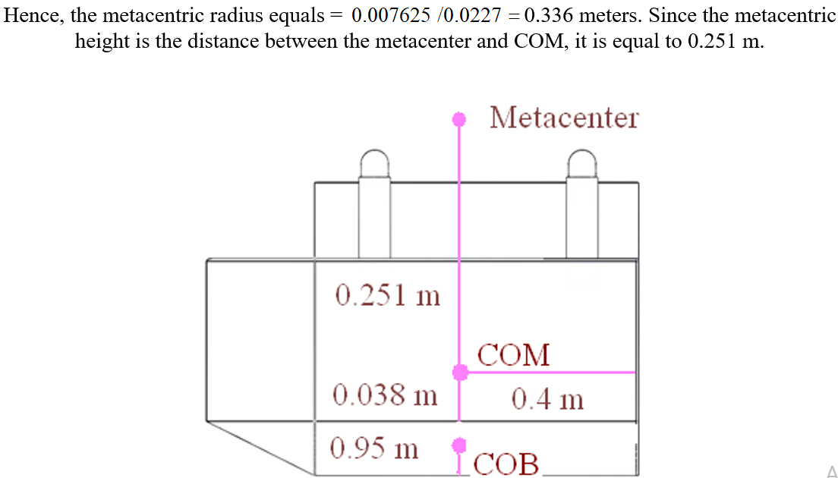
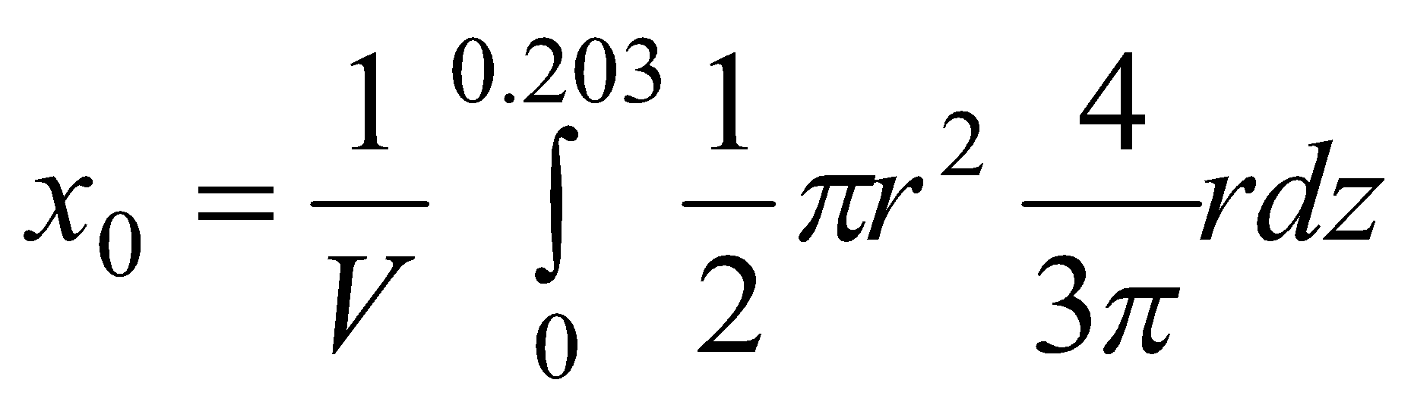
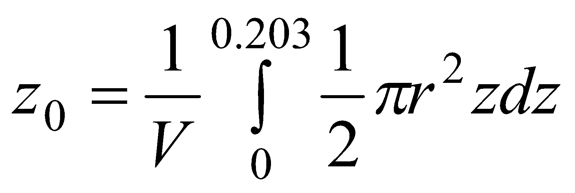
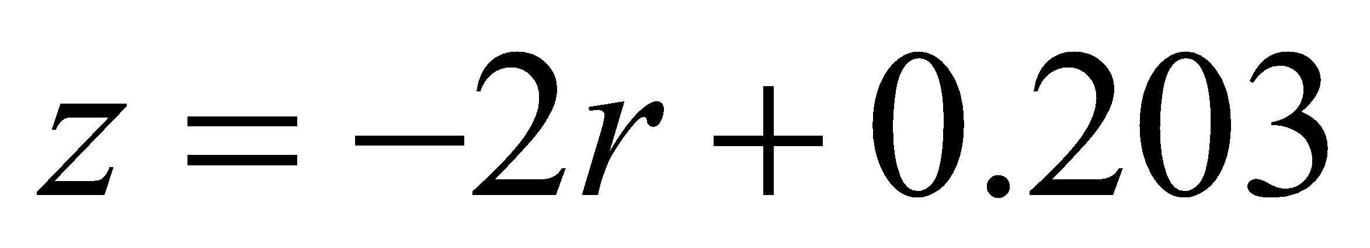
Task 4 Implementation (Cont)
Center of mass
Metacentric Height
Center of Buoyancy
Part | cubic meters | meters | meters | meters
Left semi-cone | 0.000931 | -0.1396 | 0.4295 | -0.0389
Right semi-cone | 0.000931 | 0.1396 | 0.4295 | -0.0389
Left semi-cylinder | 0.01043 | -0.1396 | 0 | -0.0475
Right semi-cylinder | 0.01043 | 0.1396 | 0 | -0.0475
Center of the buoyancy |  | 0 | 0.035203 | -0.0468
.

Slide 16
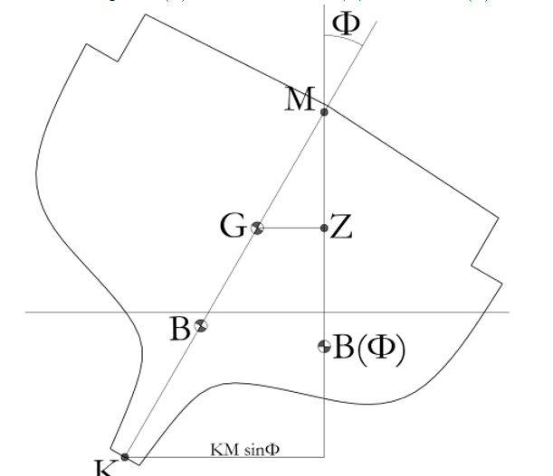
Task 4 Implementation (Cont)
Calculating Tilt.
From 0 -15 degrees.
Load displacement ranges from 0 m to 0.131 m.

Slide 17
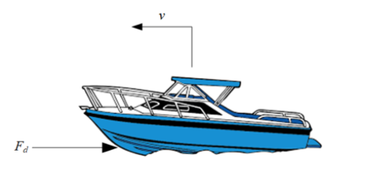
Implementation of Task 5
Drag Force
Lift Force
This will compute the fluid dynamics of the design.
We identified it by using flow simulation.

Slide 18
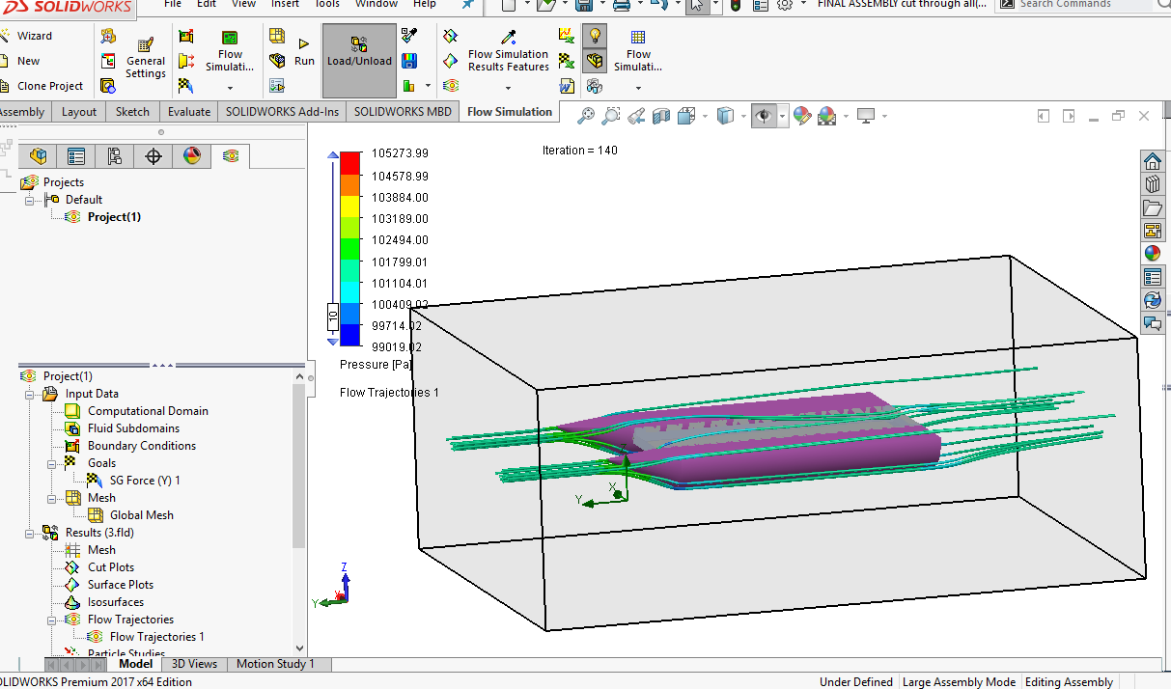
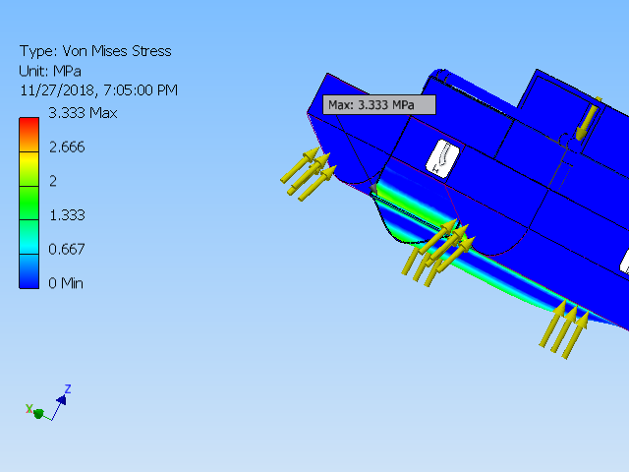
Implementation of Task 6
Flow simulation
This Calculated the drag force as 29.37 N
FEA Analysis
Name | Minimum | Maximum
Volume | 63527900 mm^3
Mass | 71.4218 kg
Von Mises Stress | 0.00000066323 MPa | 3.333 MPa
1st Principal Stress | -0.840666 MPa | 2.82522 MPa
3rd Principal Stress | -3.2432 MPa | 1.257 MPa
Displacement | 0 mm | 0.160998 mm
Safety Factor | 15 ul | 15 ul

Slide 19
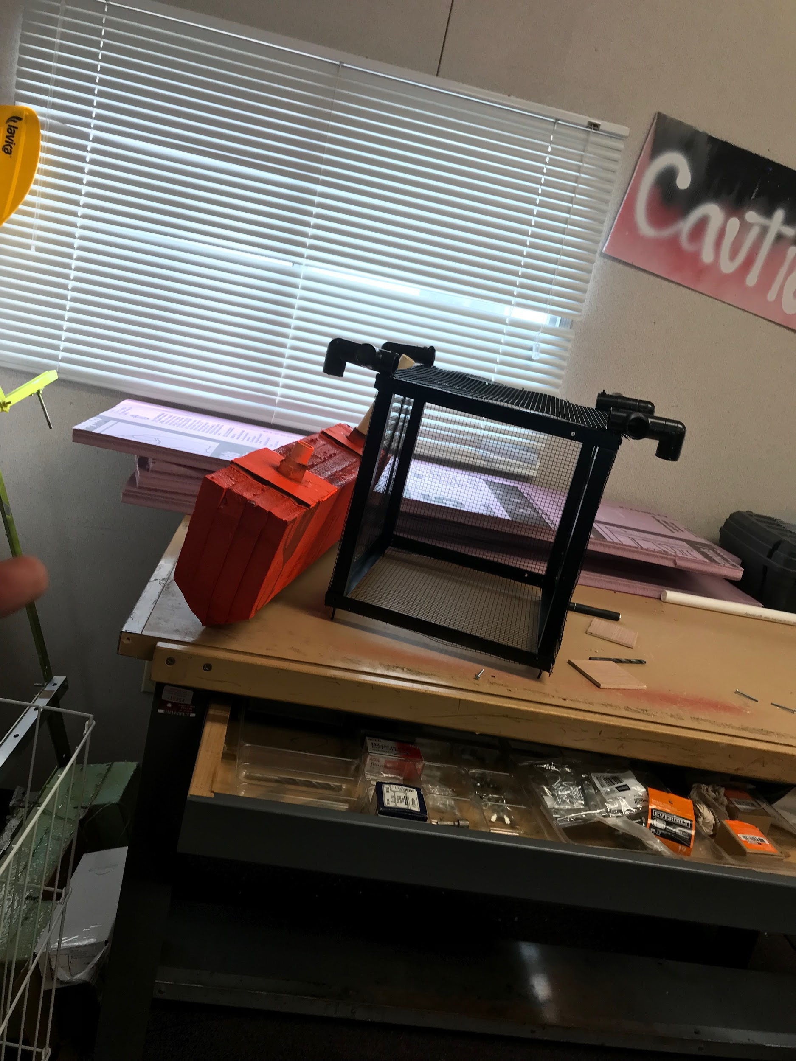
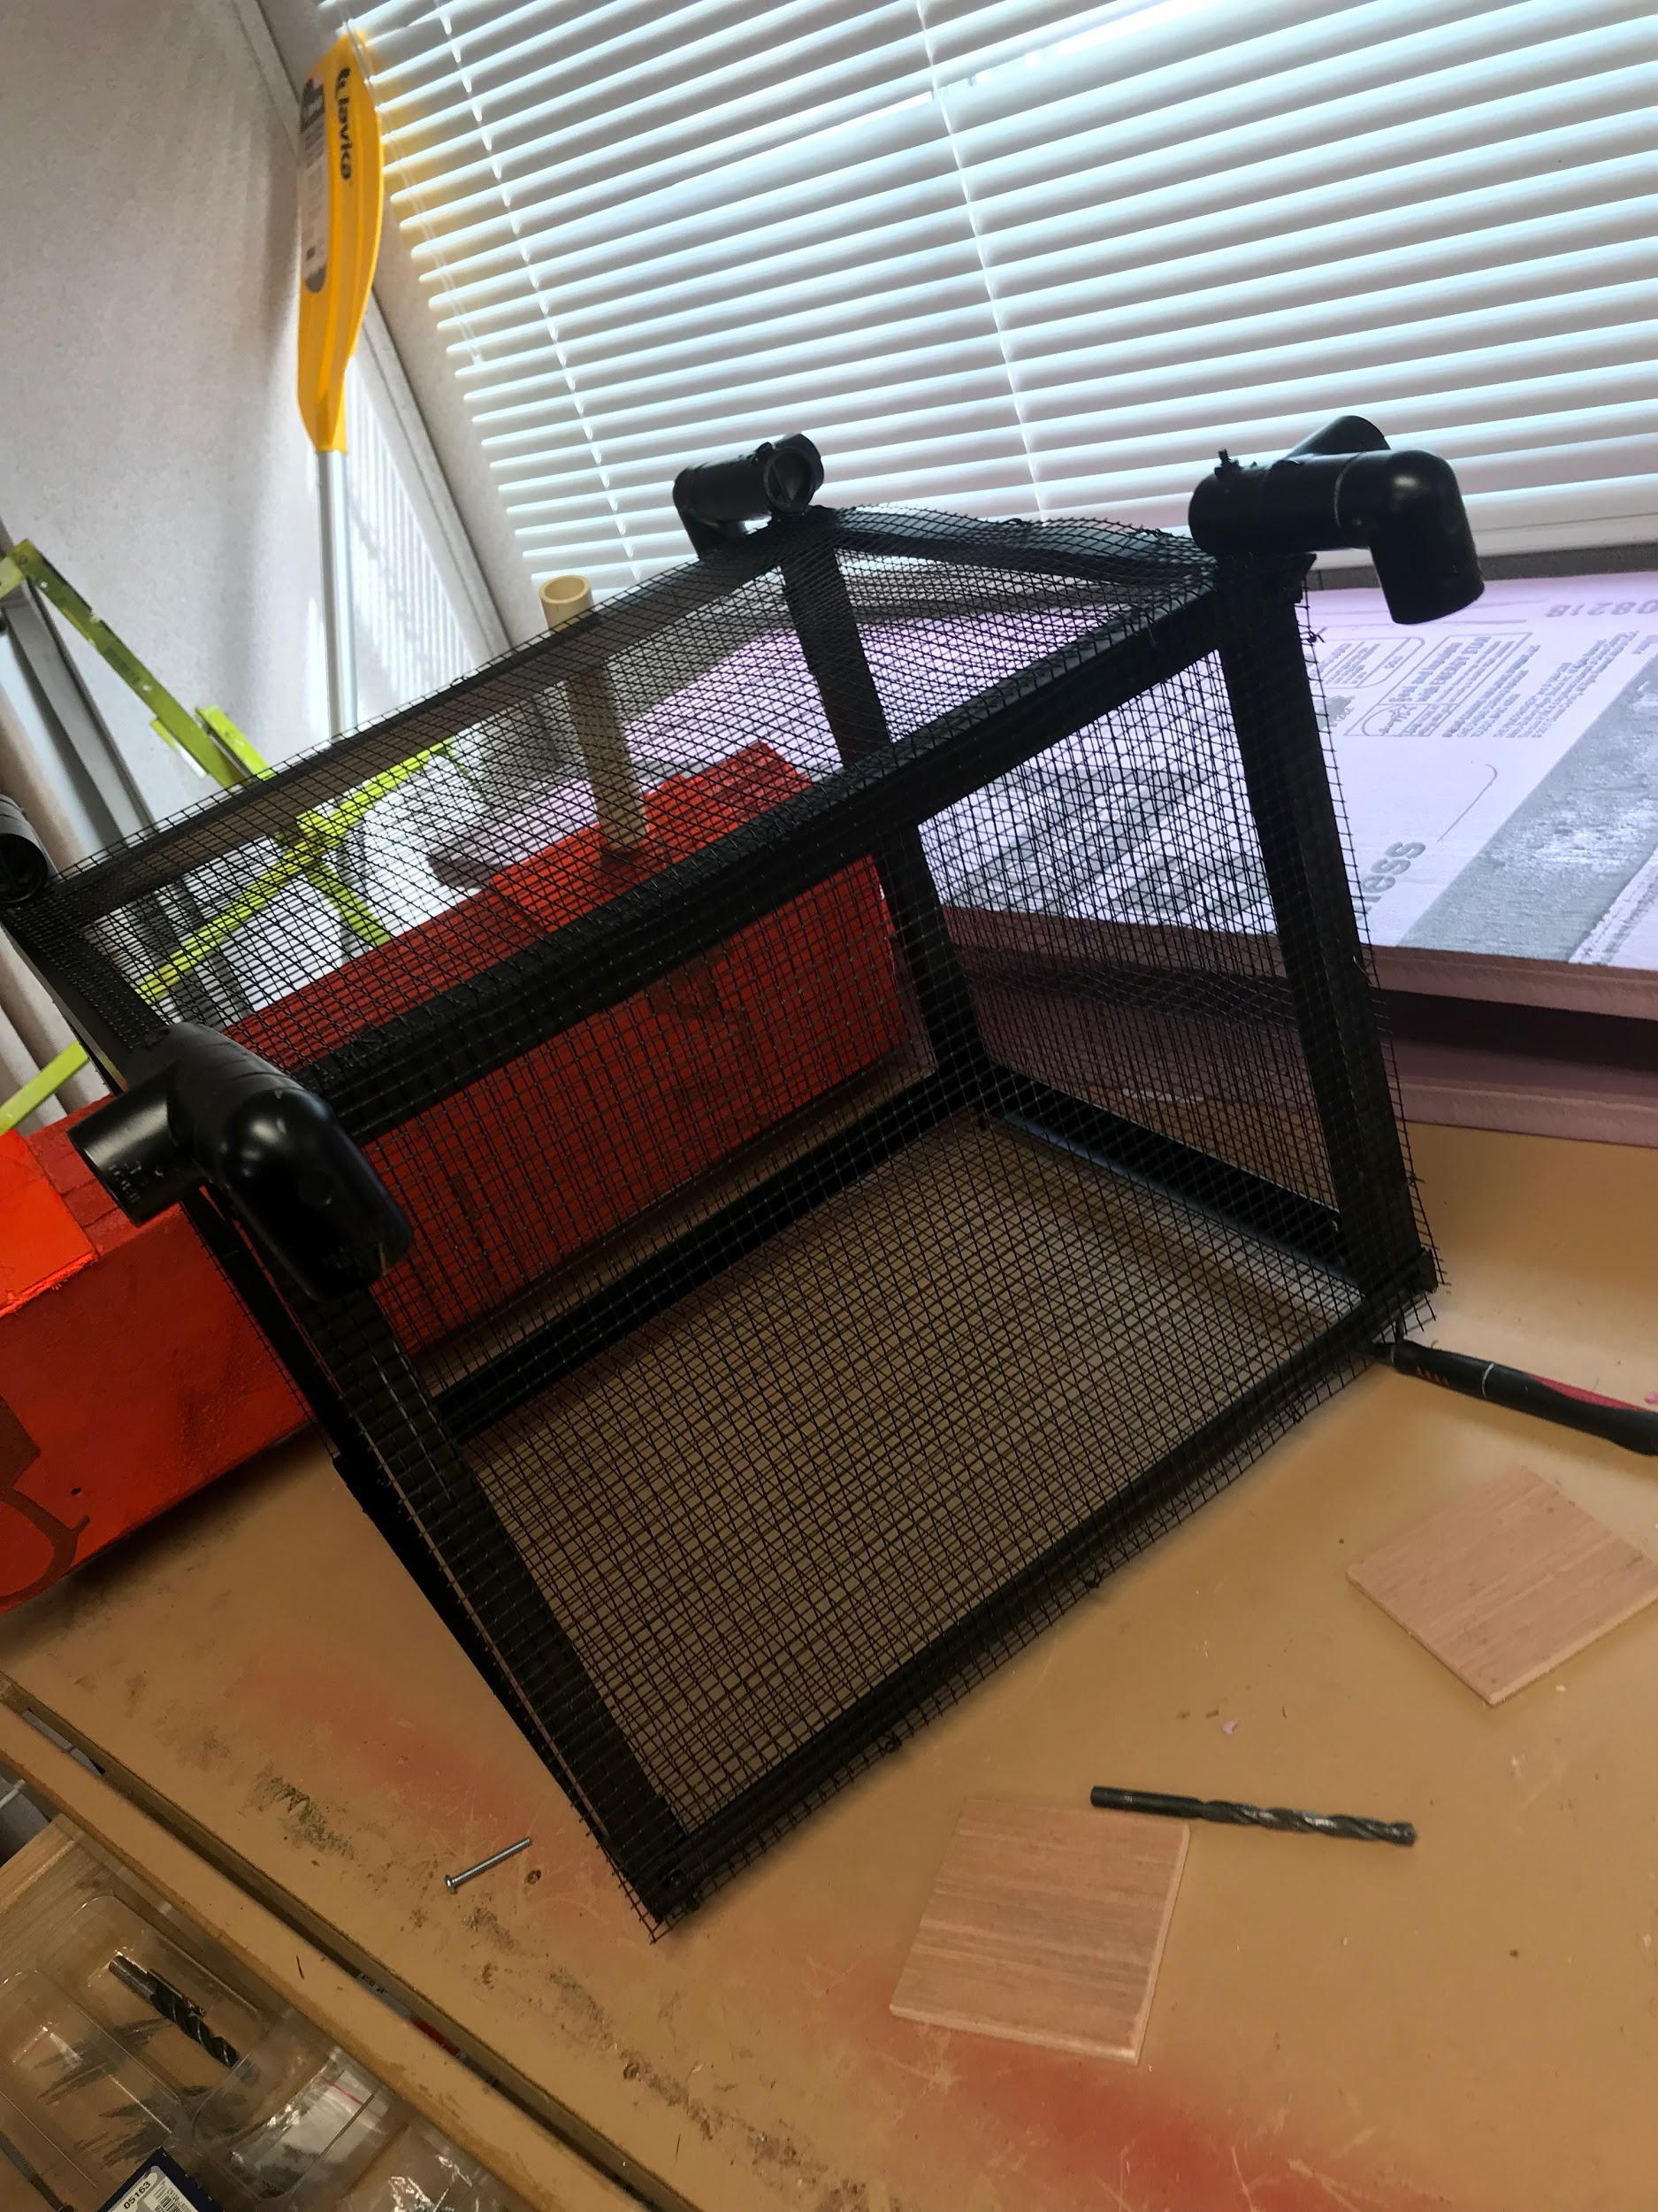
Implementation of Task 7
Parts used:
PVC, PVC couplings, Aluminum mesh, Aluminum L bars and square bars, PInk foam, Various nuts and bolts, Paint, wooden cubes 3*3*3
Finished product can be seen in the pictures.

Slide 20
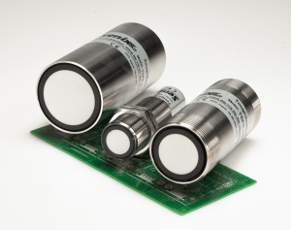
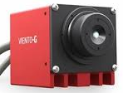
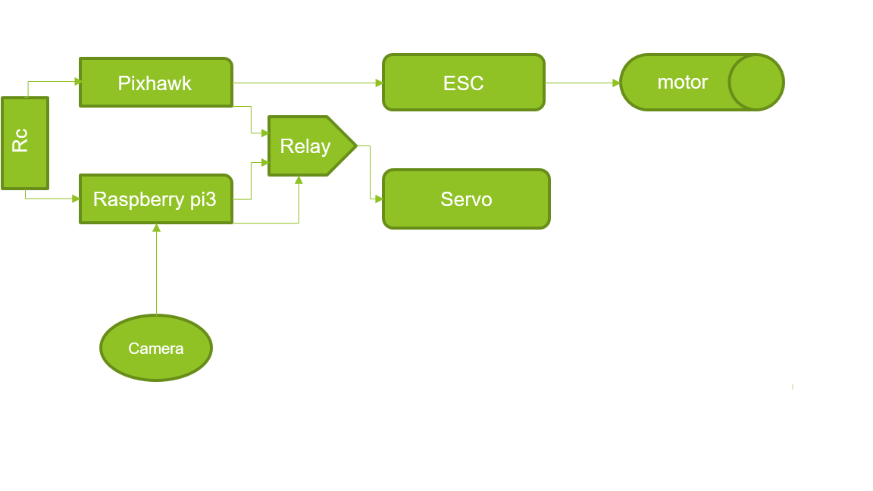
Implementation of task 1
Research on best way to implement intelligence
Power supply
Selecting electrical components
Integrating the autonomy and intelligence efficiently

Slide 21
Implementation of task 2
Raspberry pi 3
Camera
Micro SD card
Battery ( two 3 cell li-po)
Pixhawk
Ubec x2
Voltage regulator
Motor
Electronic Speed Converter (ESC)
Radio Controller & Receiver
Servo

Slide 22

Implementation of task 2 (Cont)
Battery
ESC
motor
Ubec
PI 3
Ubec
Pixhawk
servo

Slide 23
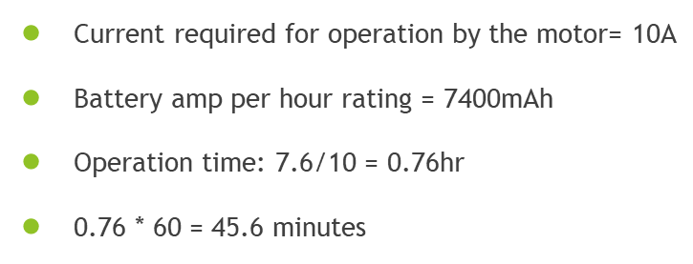
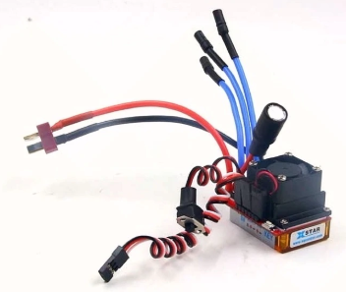
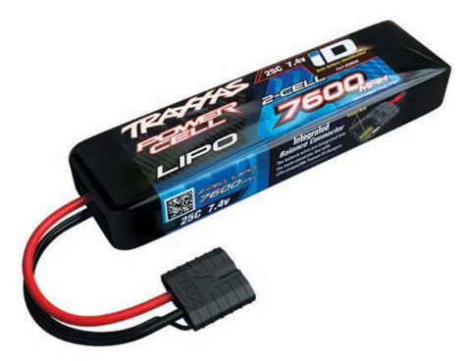
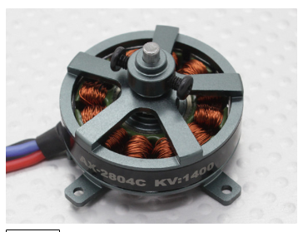
Implementation of task 2 (Cont)
Fist calculate Acceleration.
Use it to calculate Thrust force.
Use the force to Calculate power.
Determine RPM required by chosen prop.
Use RPM to identify motor.

Slide 24
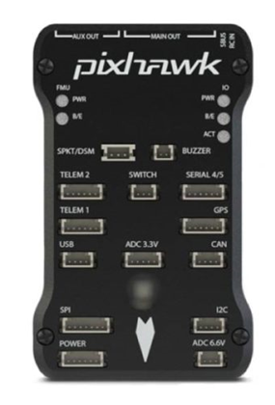
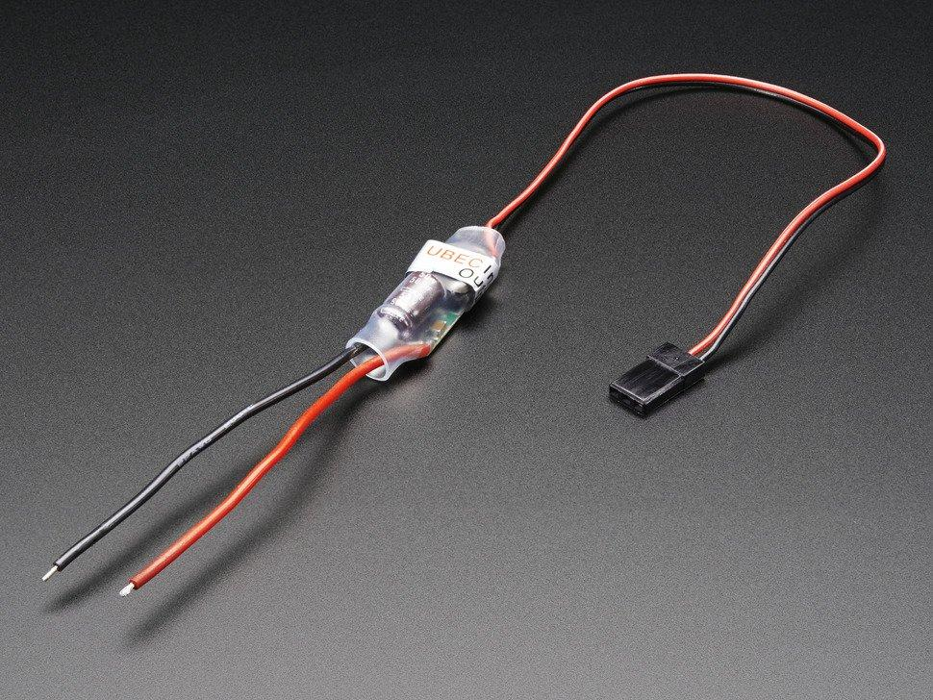
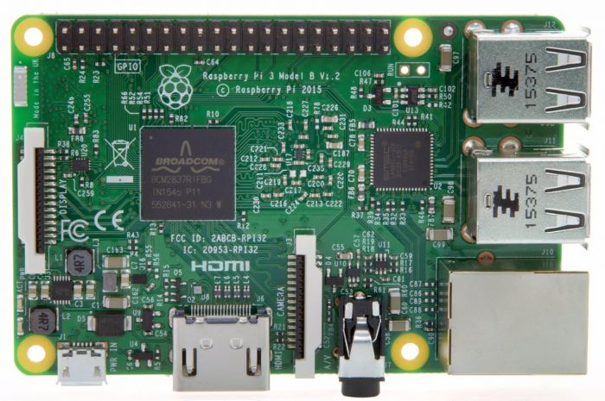
Implementation of task 2 (Cont)
The battery is connected in parallel to two ubec which is connected to the raspberry pi and pixhawk
The current required by the microcontroller are 2.5 and 2.25
Total current drawn = 4.75 A
Battery amp per hour rating = 7600mAh
Operation time: 7.6Ah / 4.75A = 1.6
Which is 1hr 36 mins

Slide 25
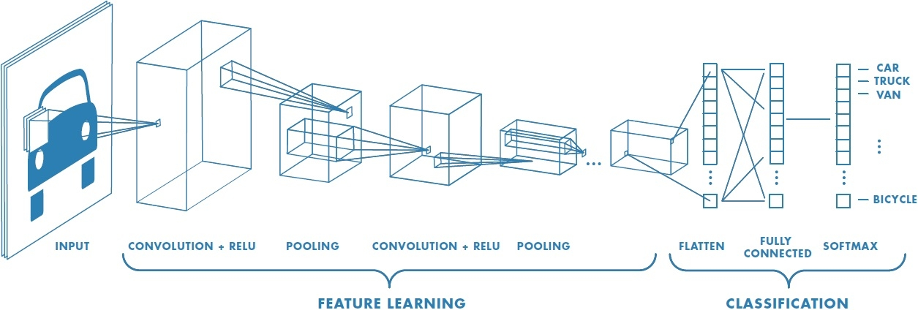
Implementation of task3
Parameters are convoluted with filters to refine the values
Operations such as Pooling and striding are employed to manipulate the size of the convolution matrix
The arrays of the parameters are aligned to form a single in the classification section then compared to the softmax

Slide 26
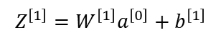
Implementation of task3 (Cont)
Convolution (z = w-a+1)
Max pooling of 2 strides (w=a/2)
W=6x6
Z=4x4
1 | 7 | 5 | 8
1 | 5 | 9 | 3
1 | 6 | 7 | 8
3 | 5 | 8 | 3
*
A=3x3
7 | 9
6 | 8
Stride Convolution (v = (n-f)/s + 1 )
1 layer of a convolution neural network
W=7x7
Z=4x4
*
A=3x3

Slide 27
Implementation of task3 (Cont)
5 | 5 | 5 | 0 | 0 | 0
5 | 5 | 5 | 0 | 0 | 0
5 | 5 | 5 | 0 | 0 | 0
5 | 5 | 5 | 0 | 0 | 0
5 | 5 | 5 | 0 | 0 | 0
5 | 5 | 5 | 0 | 0 | 0
0 | 15 | 15 | 0
0 | 15 | 15 | 0
0 | 15 | 15 | 0
0 | 15 | 15 | 0
1 | 0 | -1
1 | 0 | -1
1 | 0 | -1
*
*

Slide 28
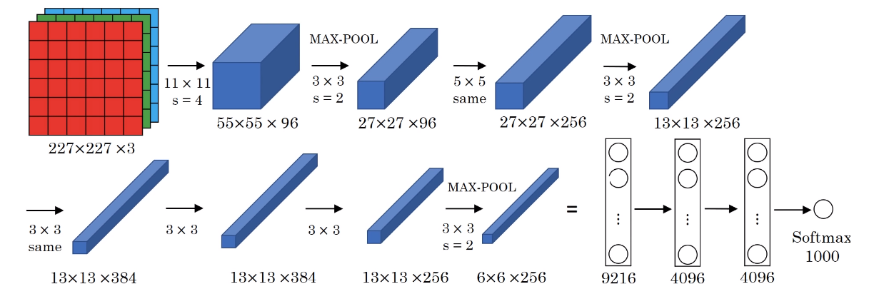
Implementation of task3 (Cont)
Utilized transfer learning
Cnn contains 8 layers
1,984 nodes
About 6 million parameters

Slide 29
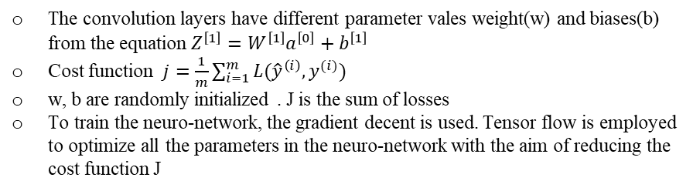
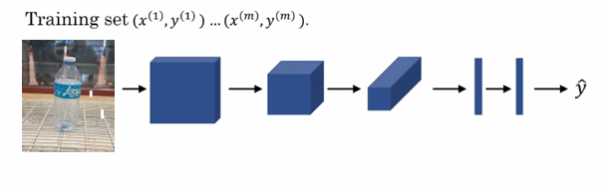
Implementation of task3 (Cont)

Slide 30
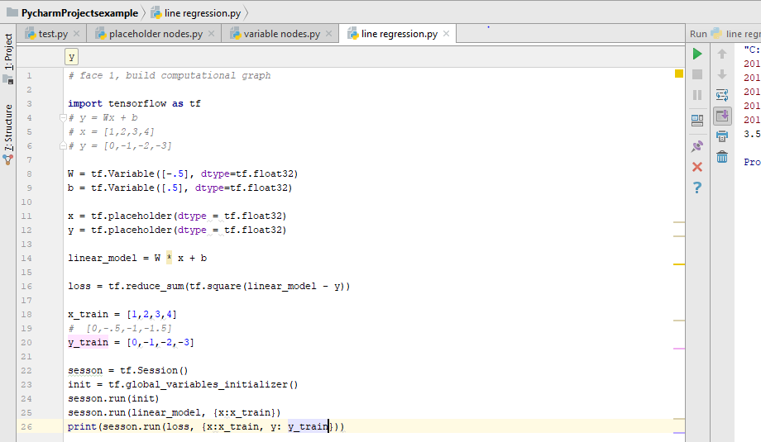
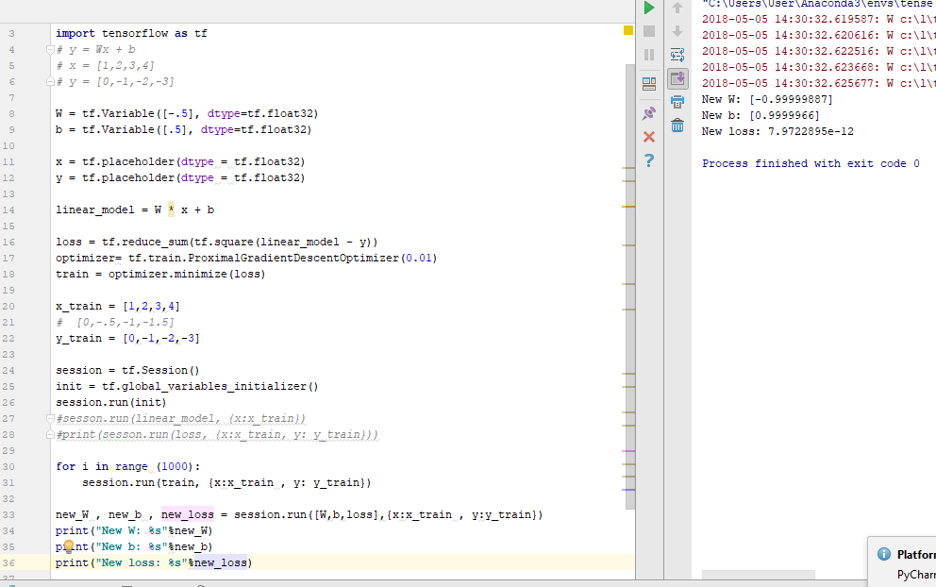
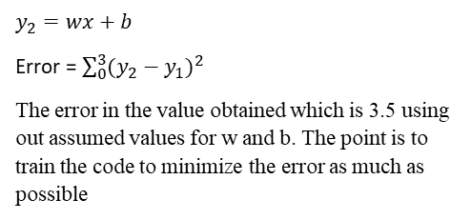
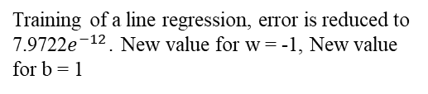
Implementation of task3 (Cont)

Slide 31



Implementation of task3 (Cont)
Set up for the Object Detection API includes:
Upgrade the Raspberry pi
Installed tensorflow
Install Opencv
Install Protobuf
Set up Tensorflow directory structure and the pythonpath variable

Slide 32

Implementation of task3 (Cont)
The Setup was functional
The frame rate was low
Higher frame rate can be achieved with a pi cam
The pi cam was not compactible
Upgrade from a pi2 to a pi3 gave me a higher FPS

Slide 33


Implementation of task3 (Cont)
Installing Tensorflow-GPU
Setting up anaconda Virtual Environment and the Object Detection directory structure
Gathering and labeling pictures
Generating training data
Creating a label map and configuring training
Training
Exporting the inference graph
Testing and using your newly trained object detection classifier

Slide 34



Implementation of task3 (Cont)
Tensorflow 1.5 was successfully installed
Was able to identify the images from the Jupiter script
The conditions had to be adjusted satisfy the tf version

Slide 35


Implementation of task3 (Cont)
Testing (47 pictures)
Training (198 pictures)

Slide 36



Implementation of task3 (Cont)
The pictures were labeled using the llabelmg software, and then xml files which contains the co-ordinate values of all the pictures were generated.
After running that, csv file is generated in the object detection folder

Slide 37

Implementation of task3 (Cont)
Tensor flow trains the system and error reduces as number of cycles increase

Slide 38
Implementation of task3 (Cont)
After uploading the trained cnn into the raspberry pi, the training was tested by going into the object detection folder and running the code

Slide 39


Implementation of task3 (Cont)
Accuracy of 94 % and 86 % respectively.

Slide 40


Implementation of task 4
Pixhawk is autopilot micro controller
It will be the primary navigation of the whole system
It will be programmed to move the boat along the specific paths acquired by setting wave points with the mission planner software

Slide 41
Implementation of task 4(Cont)
Pixhawk
ESC
motor
Rc
Raspberry pi3
Servo
Pixhawk primary controls the vessel
An Rc is utilized for manual control
Raspberry pi is able to communicate with the pixhawk using the MAV link protocol over a serial port connection
Camera

Slide 42
Future Plans
Implementing a more secure collection chamber
Implementing a lighter collection chamber to further lower the overall weight.

Slide 43
Questions?

